Slide 1
Use Case
Anonymized agrivoltaics deployment

Slide 2

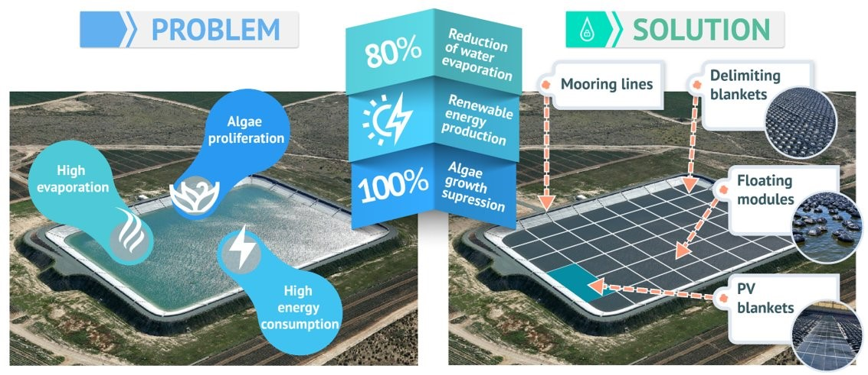
Use case – Anonymized agrivoltaics project
GEOGRAPHICAL LOCATION
Murcia (Spain)
Palmela (Portugal)
TYPES OF PARTNERS INVOLVED:
Irrigators' Community of Lorca
Farmers' Association: AVIPE
Technological Center: anonymized
Innovative Companies: ARANA, ARADA &GFI
PROJECT BUDGET:
1,8 M€ | 3 years
This project has received funding from the European Union’s LIFE 2021-2027 Prorgramme under grant agreement nº 101074546
Notes:
The anonymized project is a Horizon Europe initiative under the LIFE program, with a strong focus on sustainability.
Our consortium consists of six diverse partners, working together with nearly €2 million and a three-year timeline to tackle a significant challenge.
The project aims to achieve up to 80-85% control over water evaporation,
suppress algae growth without the use of algaecides
and generate renewable energy for irrigation large agricultural reservoirs.

Slide 3

Use case – Anonymized agrivoltaics deployment (I)
Floating shetup
~ 26 x 11 m (85 x 39 feet)
Pannels:
Suman smf 310-5x12DW 310W
88 units
Capacity:
27,2 kWp
Notes:
The photovoltaic floating power plant is therefore a key component of our demonstrator site in Lorca, Murcia.
Here is a picture of the power plant during the early stages of the Lorca demonstration installation. 27 pike kilowat
On the right, you can find the plant's specifications.
Take a moment to enjoy the beautiful Murcia sunset.

Slide 4
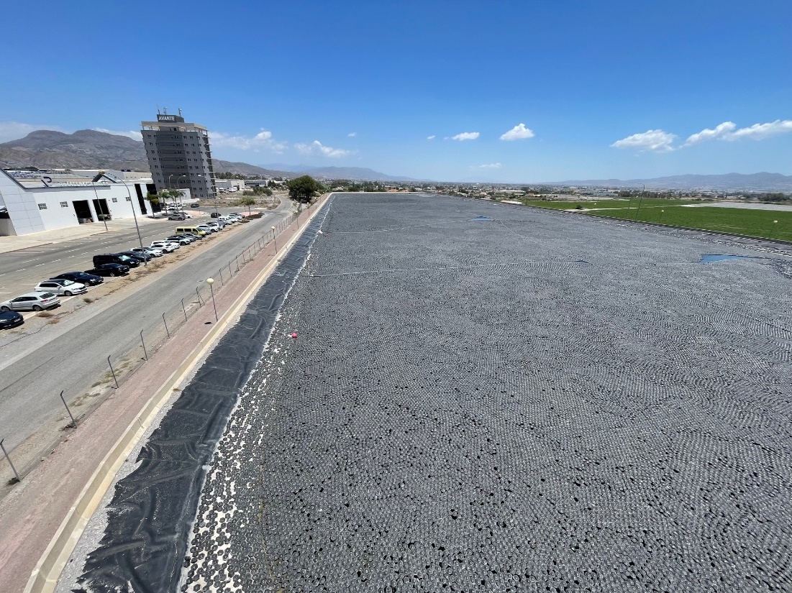
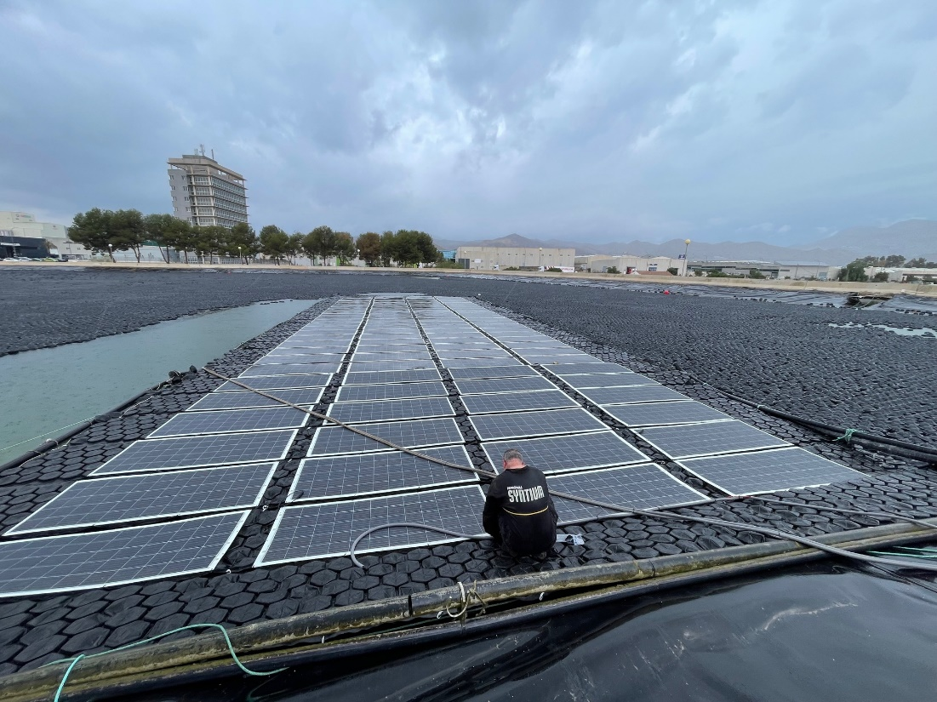
Use case – Anonymized agrivoltaics deployment (II)
Notes:
This is the fully covered water reservoir. What you see here is the complete deployment of thousands of individual floating modules alongside the floating power plant,
all installed and monitored together as one integrated system

Slide 5
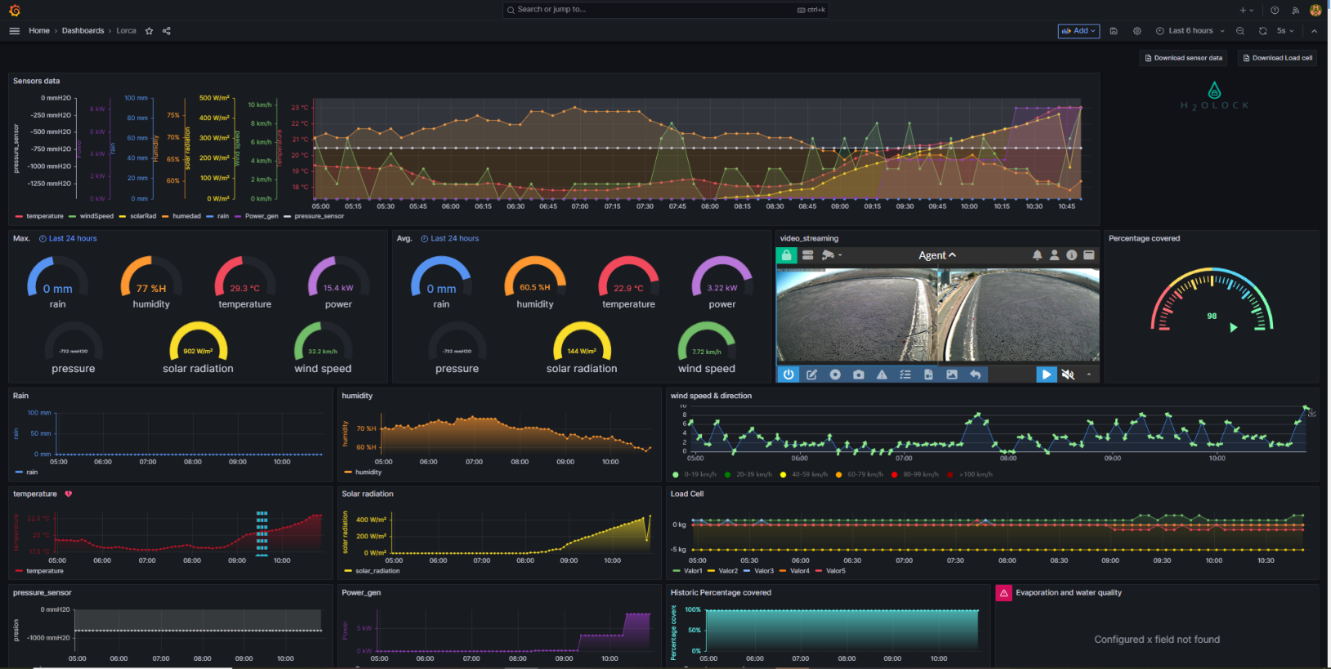
Use case – anonymized project | Problem definition
Primary user needs
Accurate short-term forecasting for the demonstrator in real-time
Informed planning and optimization of daily pumping operations
Notes:
Two main technologies were also proposed by the anonymized organization to complement the floating solution:
Accurate short-term forecasting for the demonstrator in real-time:
commercial tools are primarily focused on the design phase of PV plants, are not open-source, and cannot be integrated into dashboards.
We need to configure our own open-source tool to be implemented within the dashboard’s operational framework.
[Problem definition] To achieve an informed planning and optimization of daily pumping operations:
to maximize PV energy production, several pumping groups can be controlled through a PLC
Those pumps from the water wells up to the water pond,
It requires daily automated scheduling in base to a prediction of PV ‘free’ energy available.
This way, different pumping power levels will be activated and adjusted according to the expected daily energy production curve that has been predicted.
We don’t have a prediction. Need one.

Slide 6
Machine Learning
Applied to Photovoltaics

Slide 7
Machine Learning
EOA Literature: Top 10 publications from Q1 Journals
Ref | Title | Authors | Year | Citations | Journal | DOI
1 | Machine learning–assisted molecular design and efficiency prediction for high-performance organic photovoltaic materials | Wenbo Sun, et al. | 2019 | 156 | Science Advances | 10.1126/sciadv.aay4275
2 | Statistical Analysis and Development of an Ensemble-Based Machine Learning Model for Photovoltaic Fault Detection | Muhammad Hussain, et al. | 2022 | 15 | Energies | 10.3390/en15155492
3 | Machine learning property prediction for organic photovoltaic devices | Nastaran Meftahi, et al. | 2020 | 51 | Computational Materials | 10.1038/s41524-020-00429-w
4 | Condition Monitoring in Photovoltaic Systems by Semi-Supervised Machine Learning | Lars Maaløe, O. Winther, et al. | 2020 | 6 | Energies | 10.3390/en13030584
5 | Artificial Intelligence in Photovoltaic Fault Identification and Diagnosis: A Systematic Review | Mahmudul Islam, et al. | 2023 | 0 | Energies | 10.3390/en16217417
6 | Machine Learning Schemes for Anomaly Detection in Solar Power Plants | M. Ibrahim, et al. | 2021 | 28 | Energies | 10.20944/preprints202112.0481.v1
7 | Extreme Learning Machines for Solar Photovoltaic Power Predictions | S. Al-Dahidi, et al. | 2018 | 60 | Energies | 10.3390/EN11102725
8 | Deep and Machine Learning Models to Forecast Photovoltaic Power Generation | Sergio Cantillo-Luna, et al. | 2023 | 3 | Energies | 10.3390/en16104097
9 | Review on the Application of Photovoltaic Forecasting Using Machine Learning for Very Short- to Long-Term Forecasting | Putri Nor Liyana Mohamad Radzi, et al. | 2023 | 11 | Sustainability | 10.3390/su15042942
10 | Assessment of Machine and Deep Learning Approaches for Fault Diagnosis in Photovoltaic Systems Using Infrared Thermography | S. Boubaker, et al. | 2023 | 6 | Remote. Sens. | 10.3390/rs15061686
Notes:
After reviewing numerous papers, we found that this selection provides a comprehensive approach to AI applied to photovoltaic power forecasting.
We have included these references in this slide for further audience interest.
Now, we will highlight some key remarks extracted from here… next slide

Slide 8
Machine Learning
EOA Literature: Top 10 summary
Material design and efficiency prediction: [1][3]
Fault detection and diagnosis:[2][5][6][10]
Condition monitoring: [4]
Power forecasting: [7][8][9]
Not informed optimization techniques for model hyperparams
Rely on large and robust datasets for training
Novelty:
It faces the challenge with early-stage datasets (few months)
Non frequently used model (the XGBOOST) + informed optimization techniques
Notes:
Material design and efficiency prediction: ML models can establish relationships between chemical structures and photovoltaic properties, enabling fast screening and the acceleration of the development process of materials and silicium based technologies.
Fault detection and diagnosis: ML techniques are effective in detecting and diagnosing faults in pv systems, offering high accuracy and efficiency.
Condition monitoring: semi-supervised ML models can perform condition monitoring by leveraging unsupervised data for feature representation and classification.
Power forecasting: some ML models are applied to get accurate predictions and aiding in decision-making for energy management.
HOWEVER, these models typically rely on large and robust datasets for training, which limits their effectiveness when only early-stage data is available.
The novelty of this work is facing this challenge with employing a non frequently used model (the XGBOOST) and Bayesian optimization techniques.

Slide 9
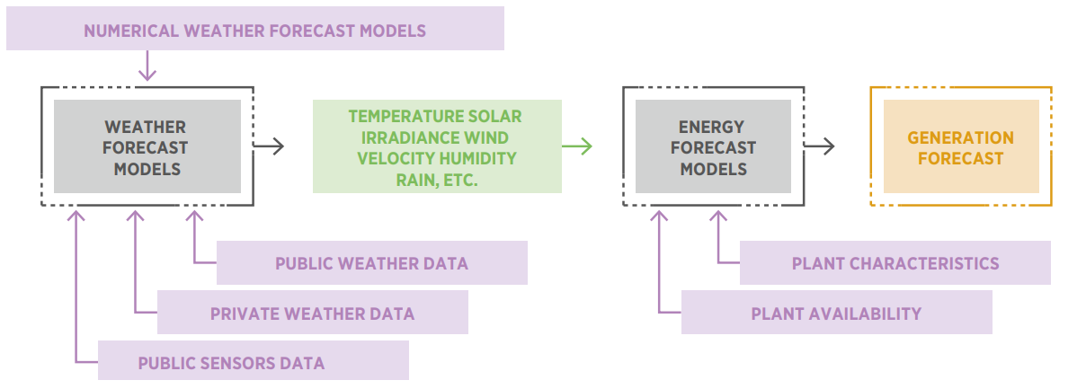
Machine Learning
Applied to Photovoltaics – Variable renewable energy (VRE) forecasting
International Renewable Energy Agency, Advanced forecasting of variable renewable power generation: Innovation Landscape Brief. 2020. [Online]. Available: www.irena.org
Notes:
This schema represents the common framework underlying state-of-the-art developments.
The work presented here builds on this framework, primarily focusing on the ingestion and curation of private weather data and the development of AI-based energy forecast models.
The goal is to be prepared for when our colleagues provide the weather variable forecasts, enabling us to produce daily power generation forecasts and integrate them into the project dashboard.

Slide 10
anonymized organization’s approach
ML development

Slide 11
Dataset characteristics
Private weather data and photovoltaic generation records
Weather station raw dataset:
Entries: 25.197
Sampling Frequency: 10 seconds
Columns:
Timestamp
Temperature (°C)
Windspeed (km/h)
Solar Radiation (W/m²)
Moisture (%)
Rain (mm)
Pressure (mmH₂O)
Photovoltaic plant raw dataset:
Entries: 257
Sampling Frequency: Daily
Columns:
Timestamp
PV Yield (kWh)
Output
Records from 1 February 2024, covering approximately the first eight months; data are limited
Input
Notes:
The first observation is that there is no correspondence between the registry frequencies, making it difficult to establish a clear relationship between the PV records and weather station data. A method to align them must be found.
There is a lack of consistency among columns, with varying units and 'scale factor' issues, leading to a lack of normalization. This can seriously impact the ML training process.
Finally, there are missing values, especially within the weather station raw dataset.

Slide 12
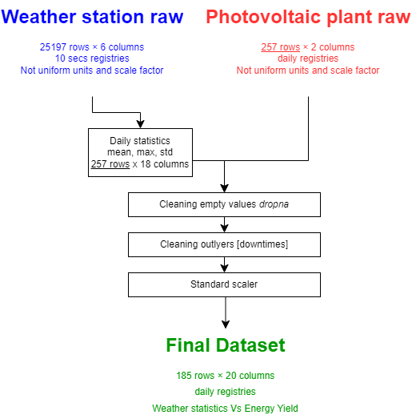
Dataset characteristics
Data curation (8 months regs.)
185 rows x 20 columns
Few samples & many features
Rare ML models in the state-of-the-art such as XGBoost
will be applied in this case
Notes:
SVM and XGBoost are ideal for a dataset with 104 samples and 24 features due to their robustness in high-dimensional spaces and their ability to handle small datasets effectively.
XGBoost’s feature selection and regularization enhance accuracy and manage complexity.

Slide 13





IA Model implementation
Methodology| OS Python 3.13.0
Jupyter notebook
framework
Bayesian/Grid searh
Hyperparameter Optimization
R2 and RMSE
Metrics
XGBOOST regresor
training dataset
Cross Validation
Validation dataset
Curated full dataset
Notes:
Methodology:
Model Training: the first step involves training an Extreme Gradient Boosting (XGBoost) machine learning model, which is well-suited for this type of dataset.
Hyperparameter Optimization: next, the model will undergo an iterative hyperparameter optimization process to identify the best possible configuration, improving its performance.
Evaluation Metrics: two metrics will be implemented to assess both the model's accuracy and its ability to generalize, based on the evaluation dataset. → RMSE (Root Mean Square Error)
Cross-Validation: finally, a cross-validation technique will be applied to enhance the model's robustness and prevent overfitting, ensuring generalization to unseen data.

Slide 14
Results and discussion

Slide 15
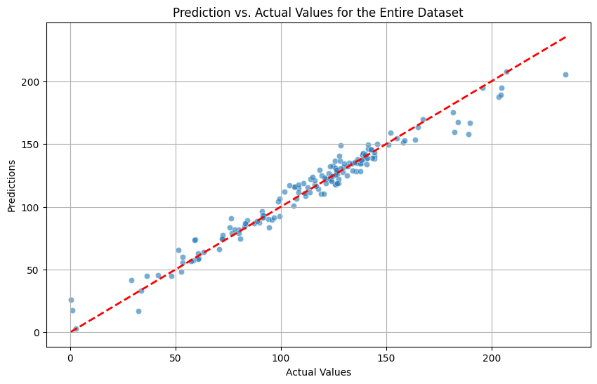
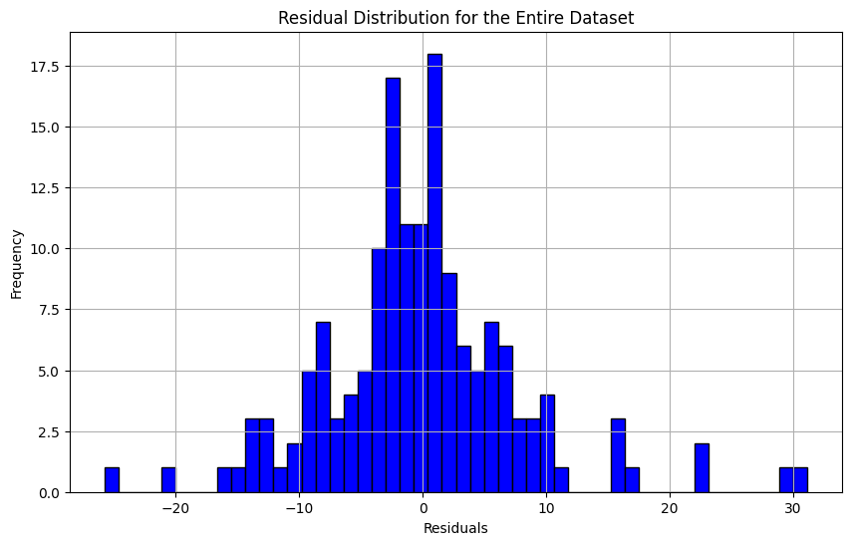
Results & discussion
Accuracy results with XGBOOST model
Metrics | Hyperparameter optimization method
 | Exhaustive Grid seach | Bayesian optimization
RMSE cross-val | 6.12 | 4.13
RMSE entire dataset | 8.02 | 9.10
R² | 0.96 | 0.98
Notes:
The accuracy and fit results obtained from both optimization methods, Bayesian and grid search, are presented here.
While both methods perform reasonably well, grid search allows for better manual intervention and results in a similar RMSE across the entire dataset compared to the training set, indicating low overfitting.
The R² score is very high, reflecting a 96% accuracy.
The prediction vs. actual values graph shows a strong correspondence, further confirming that the model does not exhibit overfitting.
Additionally, the residuals are distributed normally and symmetrically on both sides, which is another positive indicator of model performance.

Slide 16
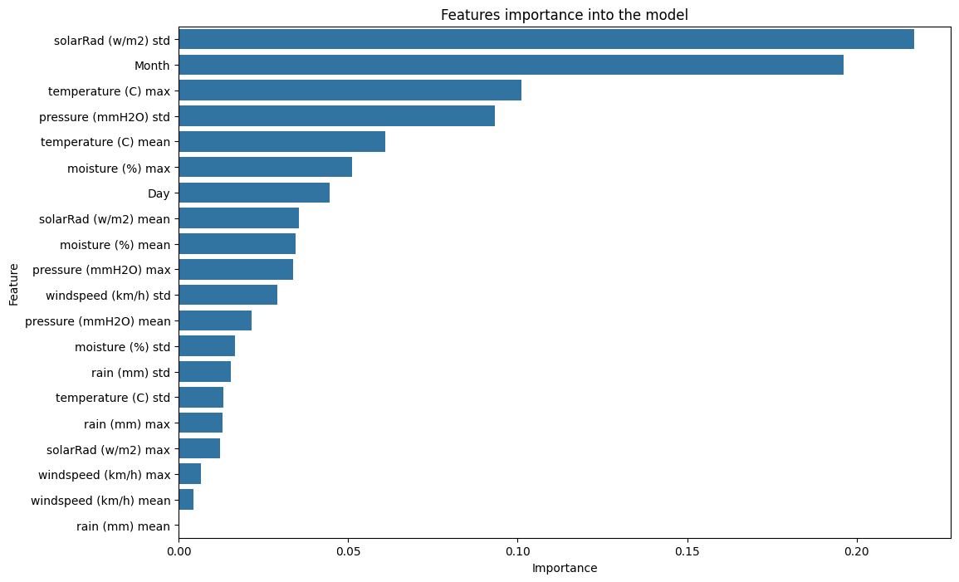
Results & discussion
Model features importance
Consistent with EoA
Weather Volatility
Cooling effects
Notes:
Solar radiation and calendar data have traditionally been key factors in power forecasting, especially in traditional models. Our machine learning model similarly identifies these as the most significant contributors.
However, the model is also shedding light on some interesting observations: cooling effects are playing a significant role in the plant's efficiency.
This use case is highly influenced by passing clouds and weather instability, which the model effectively captures.

